Slide 1
Nifty-50 Stock price Prediction
Team Members-
Aanchal Singh
Aditya Malav
Ayush Khetan
Swapnil Pandey

Slide 2
Problem statement
Firstly, Scrape data of Stock Nifty50 for last 4 years and generate different insights from that data
Secondly, Make a Machine Learning model in order to determine if the number of shares we purchased or purchase in future resulted/results in a profit or a loss, we will create a model that takes the user input such as company's buy date, selling date, and the number of stocks. The model will aim to provide insights into the future performance of the stock, enabling investors and traders to know their Profit / Loss so that they could make informed decisions about buying or selling of the respective stocks.
Lastly, create a webpage that will take input from user and predict the profit and loss

Slide 3
Execution of project PLAN
excel
Data scraping
Scraping of data from nseindia by using python Library
Generate different insights in excel and create a dashboard
ML
Create a LSTM model which will predict future profit and loss
Webpage
Create a webpage and deploy it on Streamlit app

Slide 4


Tools used
Python
Excel

Slide 5
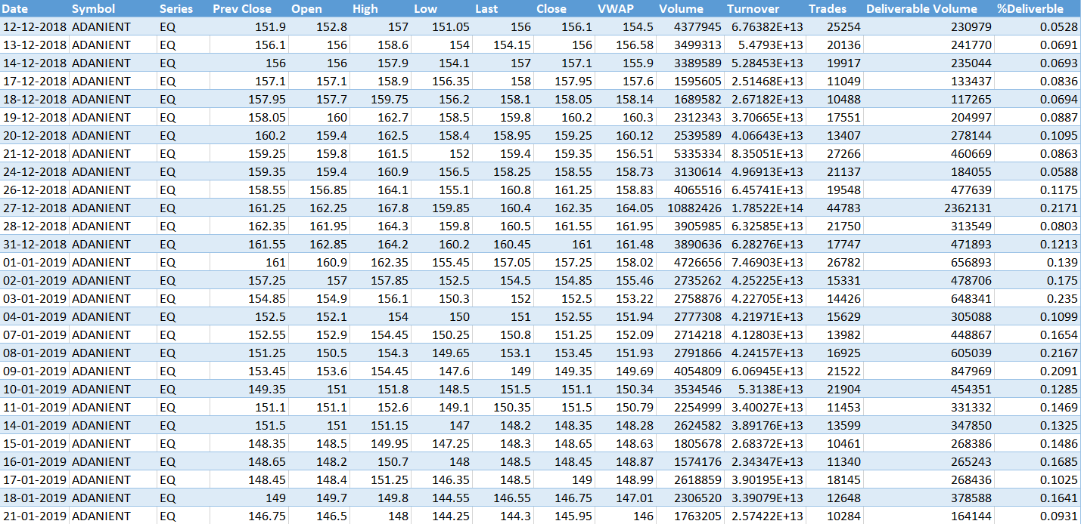
Scraped data

Slide 6
Top 10 stocks based on volume

Slide 7
Top 10 stocks based on turnover

Slide 8
Top 10 stocks based on number of profit days

Slide 9
Change in % over months

Slide 10
Price change over years
This shows price is increasing and volume is decreases which tells us if we control the turnover then price will rise up i.e supply and demand are inversly propotional to each other

Slide 12
LSTM MODEL
(LONG SHORT TERM MEMORY)
An LSTM (Long Short-Term Memory) model is a type of neural network that can handle sequential data, such as time-series data and natural language. The LSTM model can learn and remember long-term dependencies in the data, making it suitable for tasks such as speech recognition and sentiment analysis. It is considered one of the most powerful deep learning models for sequential data analysis and has achieved state-of-the-art results in many machine learning tasks.

Slide 13

Webpage

Slide 14
Challenges
All the things and processes our team went through in building this model was very much new to the team.
A lot of brain-storming was involved in making the project. Relying completely on internet for our understanding of codes and how to model works.
Making a webpage and deploying it was a bit of a task.
All team members are working-professionals, therefore, it was tough to manage the time for meetings and discussions regarding the project.
★No Challenge was so big that we cannot overcome it by Team Efforts

Slide 15
THANK YOU
We are Open to answer your Questions

